Slide 1
Telco Customer Churn
Nolan Long

Slide 2
The Problem
Telco is an internet service provider and would like to lower the amount of monthly cancellations known as “churn”. They have asked me to use a data driven methodology to target customers who are likely to cancel.

Slide 3
The Data
CSV
7,043 customer entries
20 Columns
Mostly Categorical
3 Linear

Slide 4
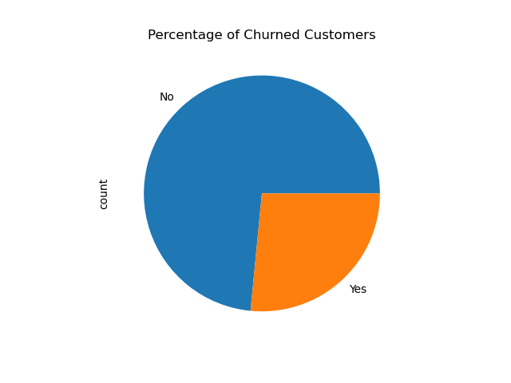
EDA
Good sample of churned customers to analyze

Slide 5
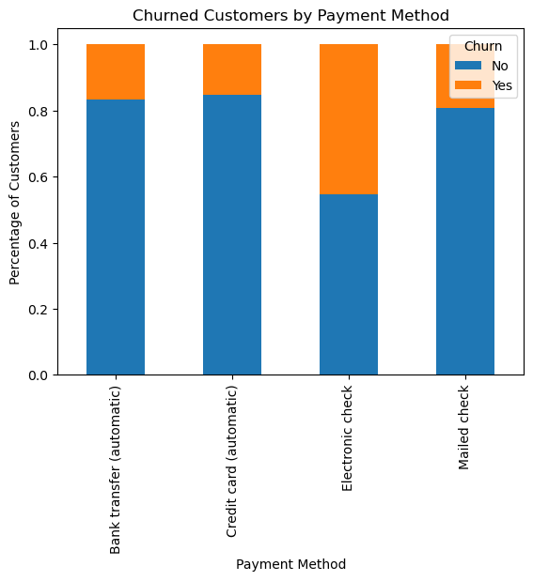
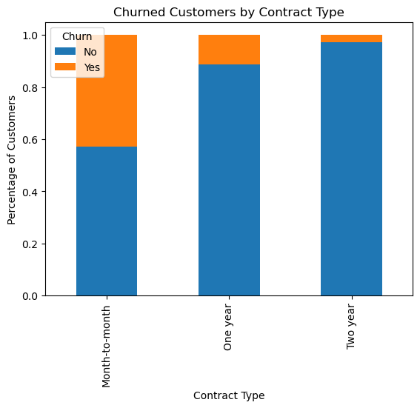
EDA
Payment Method and Contract type seem like good predictors

Slide 6
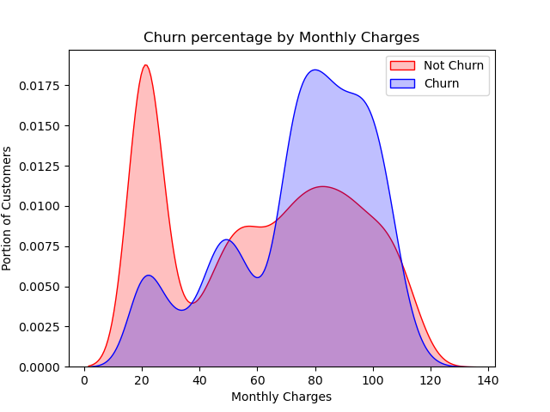
EDA
High Monthly charges could also be explanatory

Slide 7
Preprocessing
Removed CustomerID
One hot encoded categorical features
Regularized numerical features
75% 25% train test split

Slide 8
Modeling
3 Models
Logistic Regression
Decision Tree Classifier
Gradient Boosting Classifier
Accuracy as scoring method
Grid search for hyperparameter tuning

Slide 9
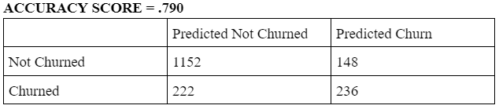
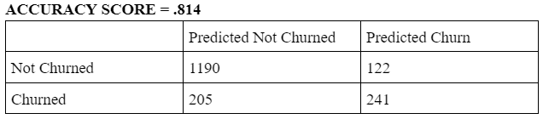
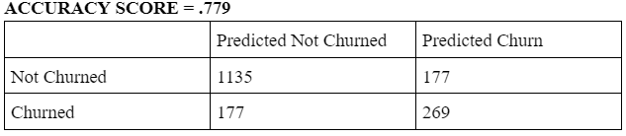
Modeling
Logistic Regression
Gradient Boosting
Decision Tree

Slide 10
Outcomes and Final Thoughts
Able to create accurate model for Telco
Found important churn factors
Important for company to adjust over time as trends change

